Slide 1
Narrowband Noise
Gaurav S. Kasbekar
Dept. of Electrical Engineering
IIT Bombay

Slide 2
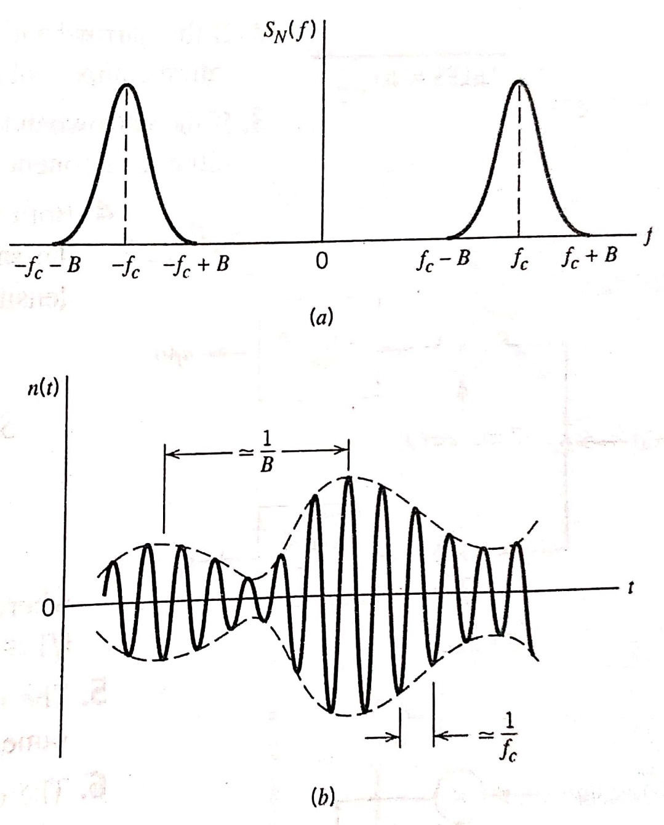
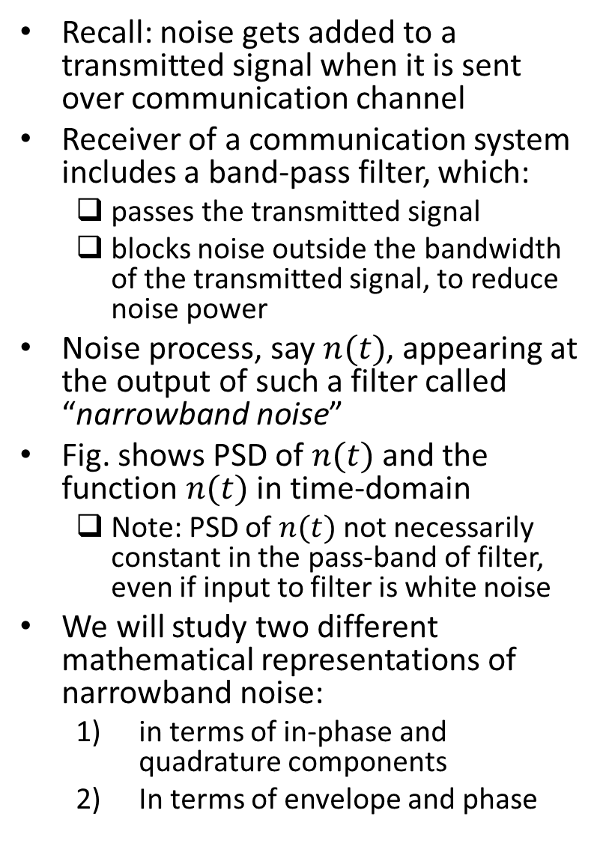
Motivation
Recall: noise gets added to a transmitted signal when it is sent over communication channel
Receiver of a communication system includes a band-pass filter, which:
passes the transmitted signal
blocks noise outside the bandwidth of the transmitted signal, to reduce noise power
Noise process, say $n(t)$, appearing at the output of such a filter called “narrowband noise”
Fig. shows PSD of $n(t)$ and the function $n(t)$ in time-domain
Note: PSD of $n(t)$not necessarily constant in the pass-band of filter, even if input to filter is white noise
We will study two different mathematical representations of narrowband noise:
in terms of in-phase and quadrature components
In terms of envelope and phase
Ref: “Communication Systems” by Haykin and Moher, 5th ed

Slide 3
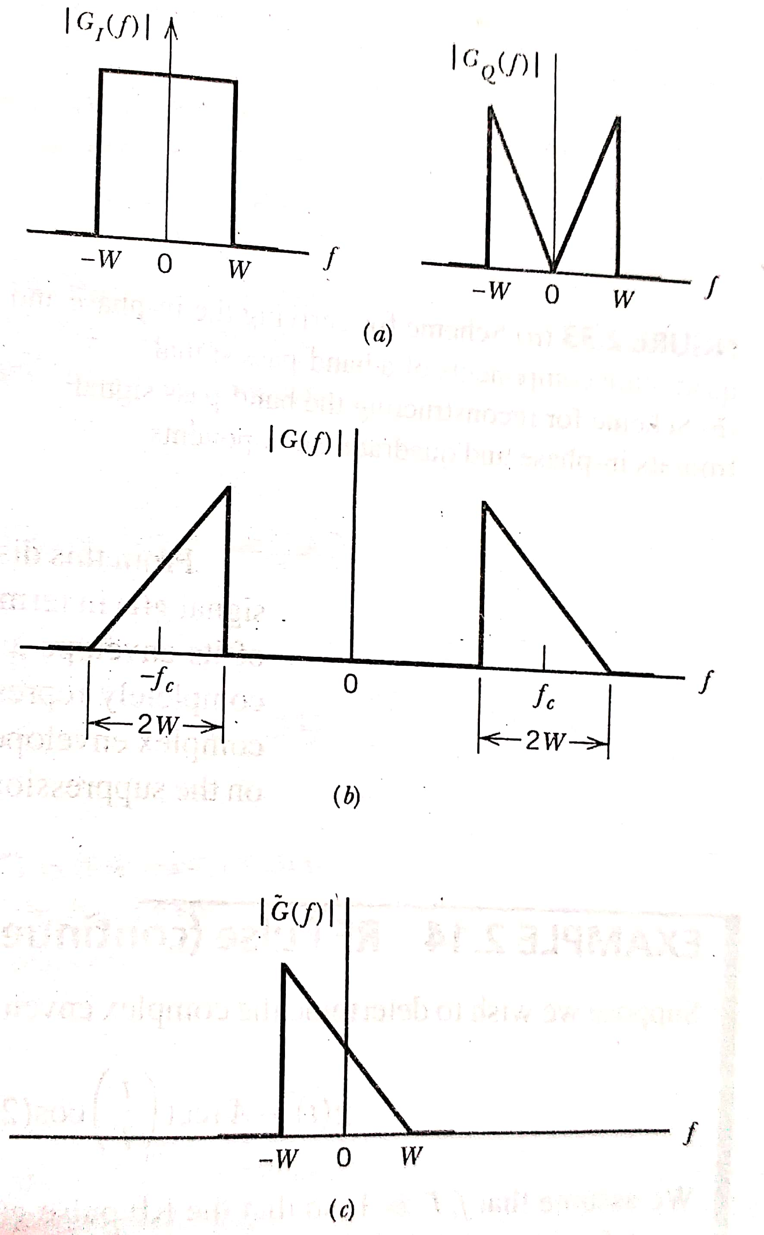
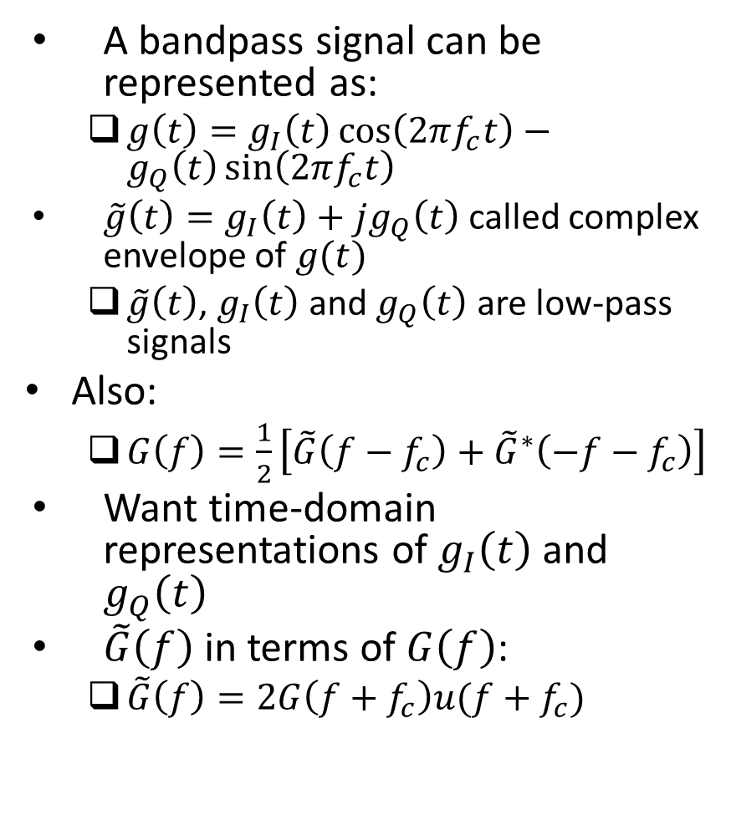
Recall: Complex Baseband Representation
A bandpass signal can be represented as:
$g\left(t\right)=g_{I}\left(t\right)\cos\left(2πf_{c}t\right)−g_{Q}\left(t\right)\sin\left(2πf_{c}t\right)$
$\tilde{g}\left(t\right)=g_{I}\left(t\right)+jg_{Q}\left(t\right)$ called complex envelope of $g(t)$
$\tilde{g}\left(t\right)$, $g_{I}\left(t\right)$ and $g_{Q}\left(t\right)$ are low-pass signals
Also:
$G\left(f\right)=\frac{1}{2}\left[\tilde{G}\left(f−f_{c}\right)+{\tilde{G}}^{∗}\left(−f−f_{c}\right)\right]$
Want time-domain representations of $g_{I}\left(t\right)$ and $g_{Q}\left(t\right)$
$\tilde{G}\left(f\right)$ in terms of $G\left(f\right)$:
$\tilde{G}\left(f\right)=2G\left(f+f_{c}\right)u(f+f_{c})$
Ref: “Communication Systems” by S. Haykin and M. Moher, 5th ed

Slide 4
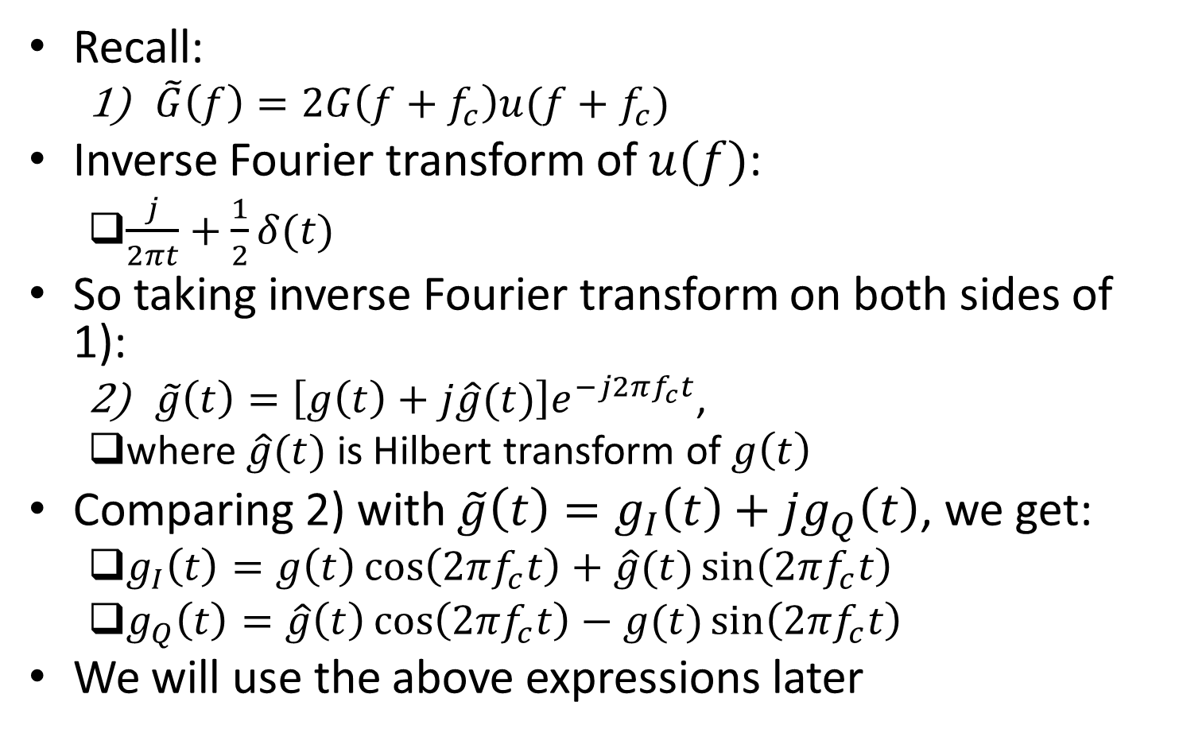
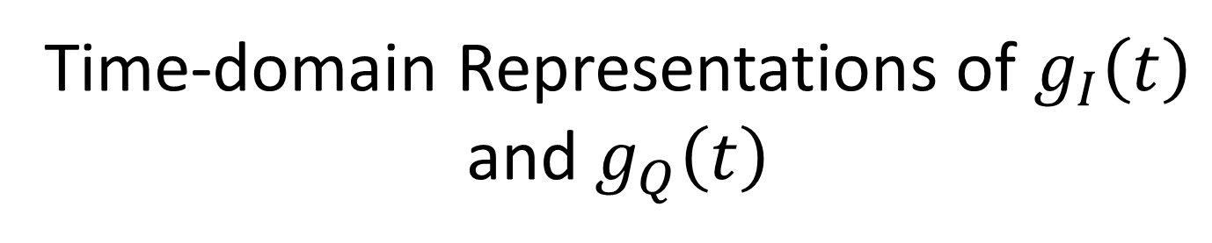
Time-domain Representations of $g_{I}\left(t\right)$ and $g_{Q}\left(t\right)$
Recall:
$\tilde{G}\left(f\right)=2G\left(f+f_{c}\right)u(f+f_{c})$
Inverse Fourier transform of $u(f)$:
$\frac{j}{2πt}+\frac{1}{2}δ(t)$
So taking inverse Fourier transform on both sides of 1):
$\tilde{g}\left(t\right)=\left[g\left(t\right)+j\hat{g}(t)\right]e^{−j2πf_{c}t}$,
where $\hat{g}(t)$ is Hilbert transform of $g\left(t\right)$
Comparing 2) with $\tilde{g}\left(t\right)=g_{I}\left(t\right)+jg_{Q}\left(t\right)$, we get:
$g_{I}\left(t\right)=g\left(t\right)\cos\left(2πf_{c}t\right)+\hat{g}(t)\sin\left(2πf_{c}t\right)$
$g_{Q}\left(t\right)=\hat{g}\left(t\right)\cos\left(2πf_{c}t\right)−g(t)\sin\left(2πf_{c}t\right)$
We will use the above expressions later

Slide 5
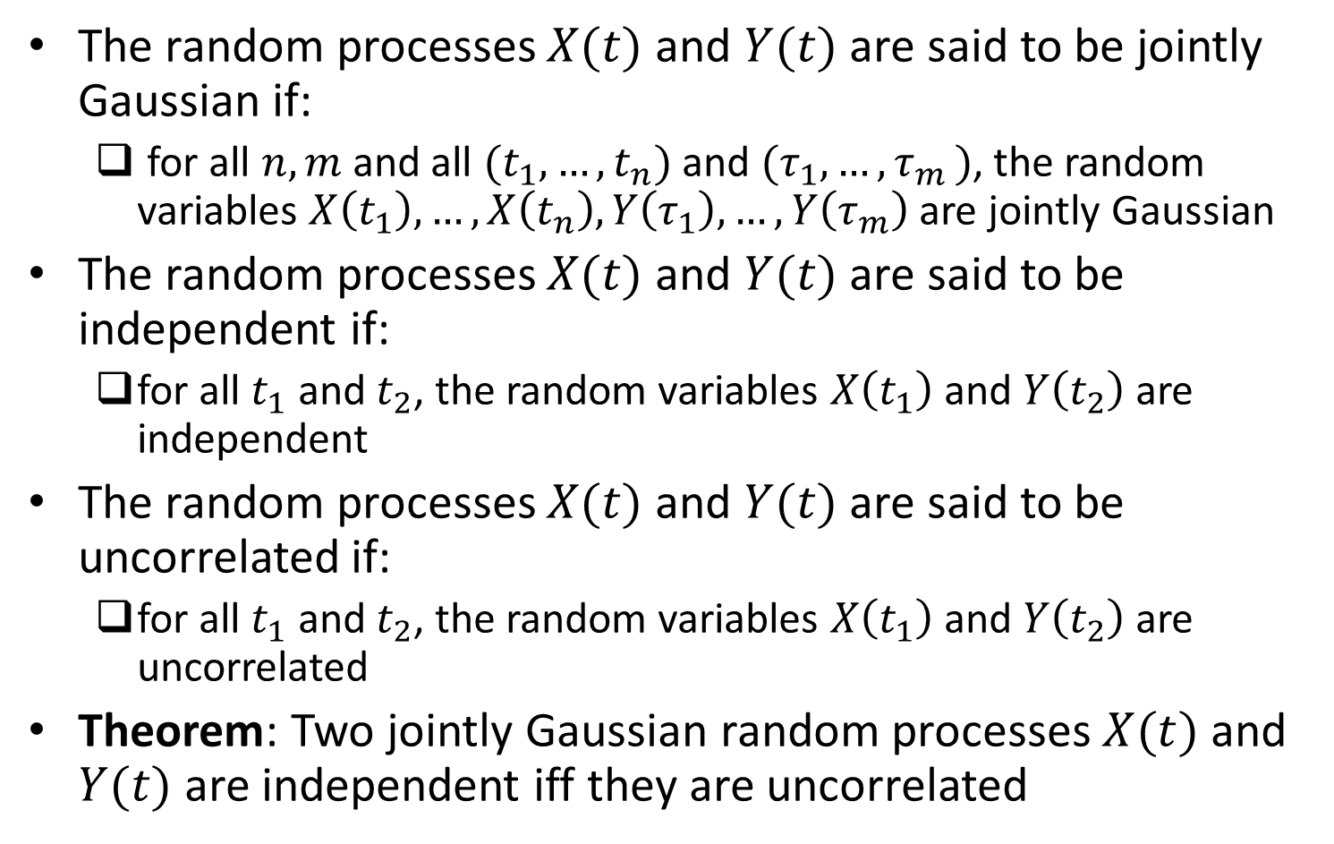
Jointly Gaussian Random Processes, Independence and Uncorrelatedness
The random processes $X(t)$ and $Y(t)$ are said to be jointly Gaussian if:
for all $n,m$ and all $(t_{1},…,t_{n})$ and $(τ_{1},…{,τ}_{m})$, the random variables $X\left(t_{1}\right),…,X\left(t_{n}\right),Y\left(τ_{1}\right),…,Y\left(τ_{m}\right)$ are jointly Gaussian
The random processes $X(t)$ and $Y(t)$ are said to be independent if:
for all $t_{1}$ and $t_{2}$, the random variables $X\left(t_{1}\right)$ and $Y\left(t_{2}\right)$ are independent
The random processes $X(t)$ and $Y(t)$ are said to be uncorrelated if:
for all $t_{1}$ and $t_{2}$, the random variables $X\left(t_{1}\right)$ and $Y\left(t_{2}\right)$ are uncorrelated
Theorem: Two jointly Gaussian random processes $X(t)$ and $Y(t)$ are independent iff they are uncorrelated

Slide 6
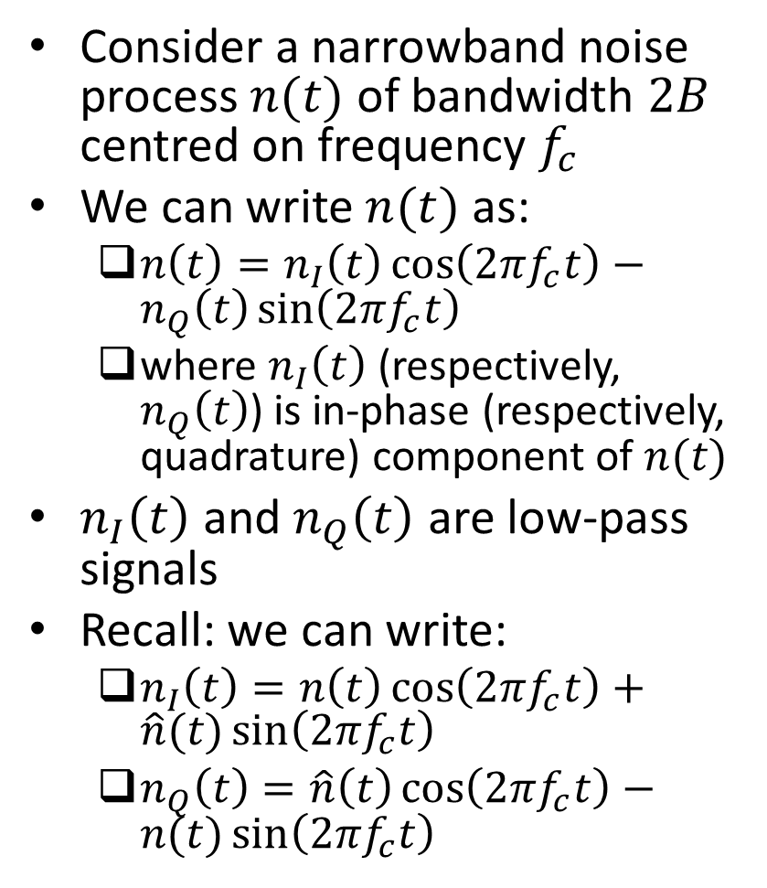
Representation of Narrowband Noise in Terms of In-Phase and Quadrature Components
Consider a narrowband noise process $n(t)$ of bandwidth $2B$ centred on frequency $f_{c}$
We can write $n(t)$ as:
$n\left(t\right)=n_{I}\left(t\right)\cos\left(2πf_{c}t\right)−n_{Q}\left(t\right)\sin\left(2πf_{c}t\right)$
where $n_{I}\left(t\right)$ (respectively, $n_{Q}\left(t\right)$) is in-phase (respectively, quadrature) component of $n(t)$
$n_{I}\left(t\right)$ and $n_{Q}\left(t\right)$ are low-pass signals
Recall: we can write:
$n_{I}\left(t\right)=n\left(t\right)\cos\left(2πf_{c}t\right)+\hat{n}(t)\sin\left(2πf_{c}t\right)$
$n_{Q}\left(t\right)=\hat{n}\left(t\right)\cos\left(2πf_{c}t\right)−n(t)\sin\left(2πf_{c}t\right)$
Ref: “Communication Systems” by Haykin and Moher, 5th ed

Slide 7
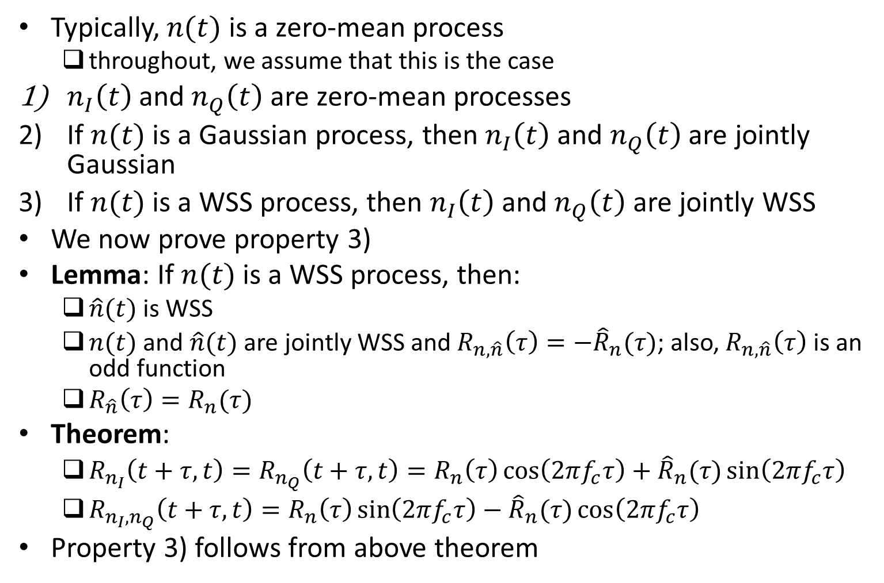
Properties of In-phase and Quadrature Components
Typically, $n(t)$ is a zero-mean process
throughout, we assume that this is the case
$n_{I}\left(t\right)$ and $n_{Q}\left(t\right)$ are zero-mean processes
If $n(t)$ is a Gaussian process, then $n_{I}\left(t\right)$ and $n_{Q}\left(t\right)$ are jointly Gaussian
If $n(t)$ is a WSS process, then $n_{I}\left(t\right)$ and $n_{Q}\left(t\right)$ are jointly WSS
We now prove property 3)
Lemma: If $n(t)$ is a WSS process, then:
$\hat{n}(t)$ is WSS
$n(t)$ and $\hat{n}(t)$ are jointly WSS and $R_{n,\hat{n}}\left(τ\right)=−{\hat{R}}_{n}(τ)$; also, $R_{n,\hat{n}}\left(τ\right)$ is an odd function
$R_{\hat{n}}\left(τ\right)=R_{n}(τ)$
Theorem:
$R_{n_{I}}\left(t+τ,t\right)=R_{n_{Q}}\left(t+τ,t\right)=R_{n}\left(τ\right)\cos\left(2πf_{c}τ\right)+{\hat{R}}_{n}(τ)\sin\left(2πf_{c}τ\right)$
$R_{n_{I},n_{Q}}\left(t+τ,t\right)=R_{n}\left(τ\right)\sin\left(2πf_{c}τ\right)−{\hat{R}}_{n}(τ)\cos\left(2πf_{c}τ\right)$
Property 3) follows from above theorem

Slide 8
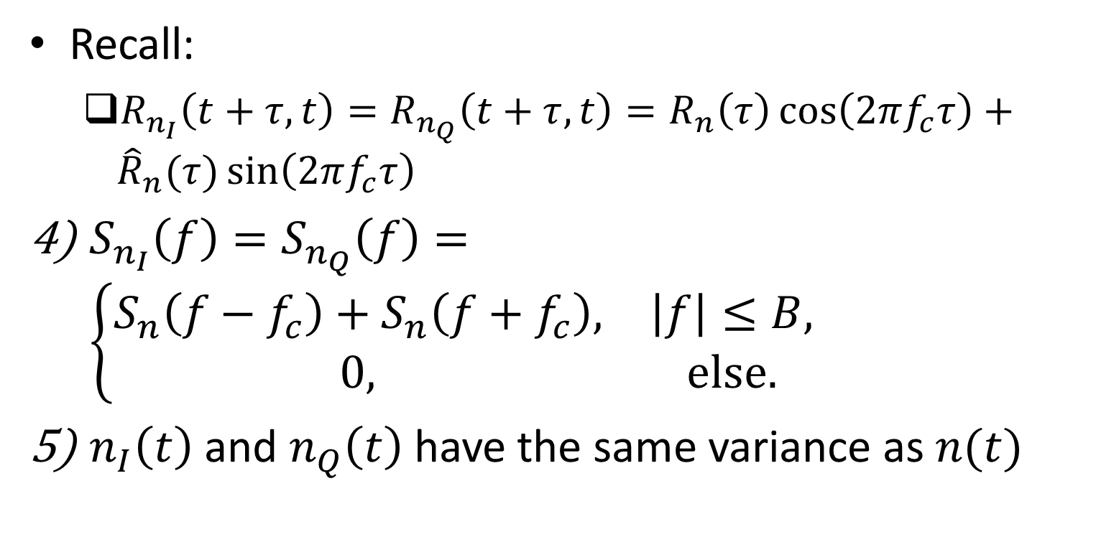
Properties of In-phase and Quadrature Components (contd.)
Recall:
$R_{n_{I}}\left(t+τ,t\right)=R_{n_{Q}}\left(t+τ,t\right)=R_{n}\left(τ\right)\cos\left(2πf_{c}τ\right)+{\hat{R}}_{n}(τ)\sin\left(2πf_{c}τ\right)$
$S_{n_{I}}\left(f\right)=S_{n_{Q}}\left(f\right)=\left\{\begin{matrix}S_{n}\left(f−f_{c}\right)+S_{n}\left(f+f_{c}\right), & \left|f\right|≤B, \\ 0, & else.\end{matrix}\right.$
$n_{I}\left(t\right)$ and $n_{Q}\left(t\right)$ have the same variance as $n(t)$

Slide 9
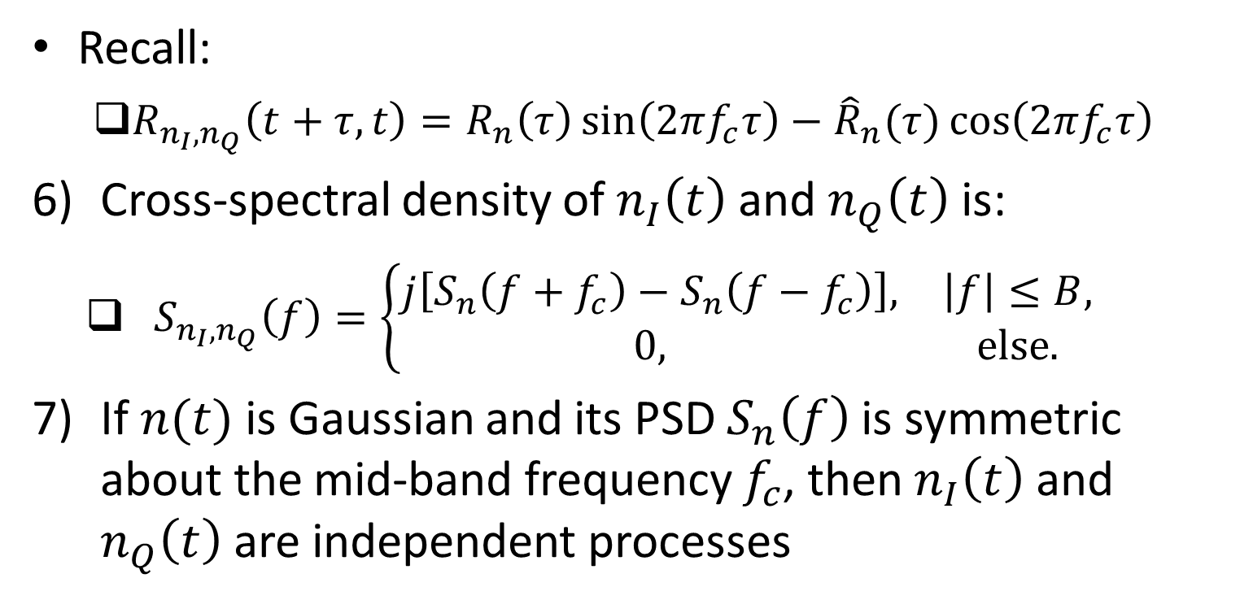
Properties of In-phase and Quadrature Components (contd.)
Recall:
$R_{n_{I},n_{Q}}\left(t+τ,t\right)=R_{n}\left(τ\right)\sin\left(2πf_{c}τ\right)−{\hat{R}}_{n}(τ)\cos\left(2πf_{c}τ\right)$
Cross-spectral density of $n_{I}\left(t\right)$ and $n_{Q}\left(t\right)$ is:
$S_{n_{I},n_{Q}}\left(f\right)=\left\{\begin{matrix}j\left[S_{n}\left(f+f_{c}\right)−S_{n}\left(f−f_{c}\right)\right], & \left|f\right|≤B, \\ 0, & else.\end{matrix}\right.$
If $n(t)$ is Gaussian and its PSD $S_{n}\left(f\right)$ is symmetric about the mid-band frequency $f_{c}$, then $n_{I}\left(t\right)$ and $n_{Q}\left(t\right)$ are independent processes

Slide 10
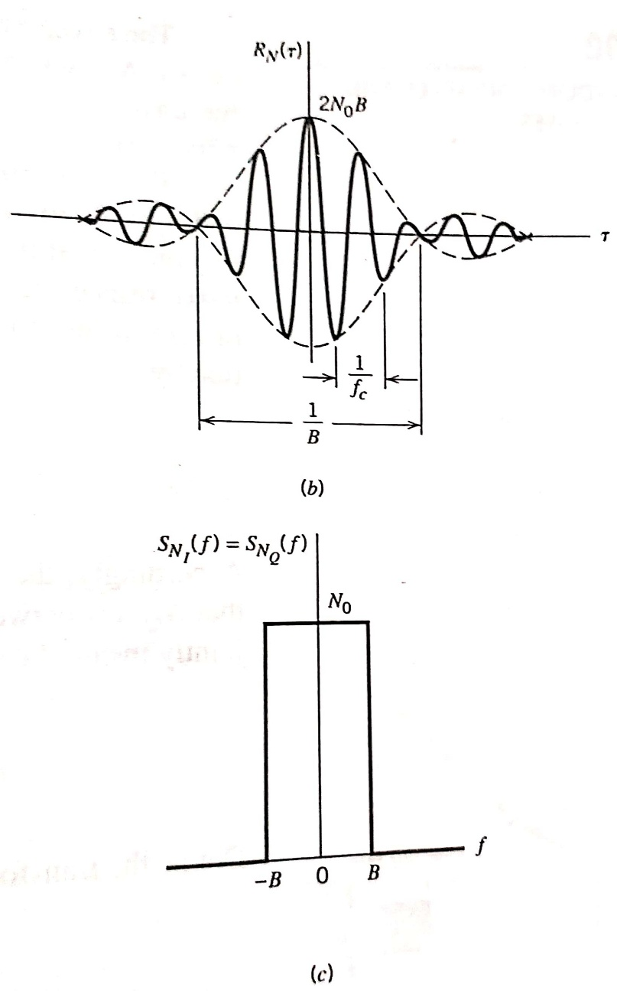
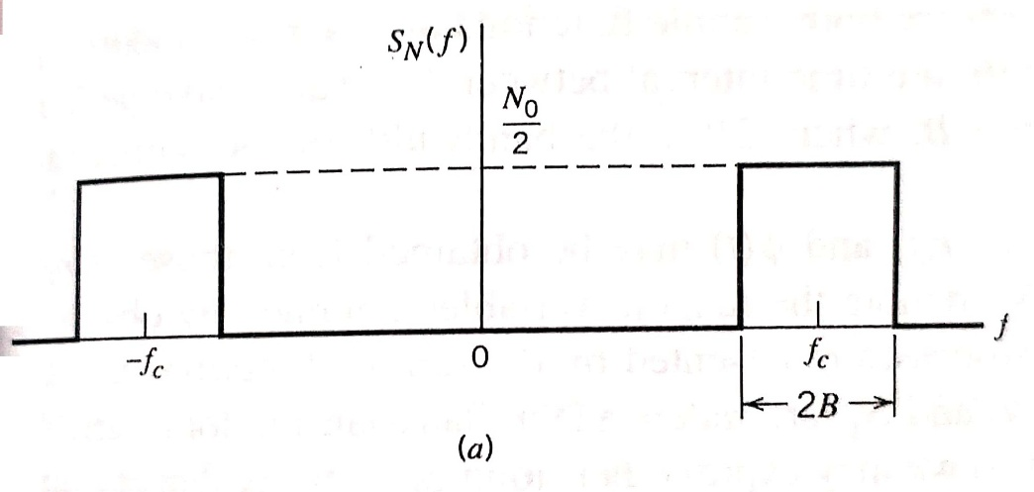

Example: Ideal Band-pass Filtered White Gaussian Noise
Consider white Gaussian noise of zero mean and PSD $\frac{N_{0}}{2}$
Passed through ideal band-pass filter of passband magnitude response $1$, mid-band frequency $f_{c}$ and bandwidth $2B$
let $n(t)$ be filtered noise
PSD of $n(t)$:
$S_{n}\left(f\right)=\left\{\begin{matrix}\frac{N_{0}}{2}, & \left|f\right|∈\left(f_{c}−B,f_{c}+B\right), \\ 0, & else.\end{matrix}\right.$
Autocorrelation function of $n(t)$:
$R_{n}\left(τ\right)=2N_{0}Bsinc\left(2Bτ\right)cos⁡(2πf_{c}τ)$
PSD of $n_{I}(t)$:
$S_{n_{I}}\left(f\right)=\left\{\begin{matrix}N_{0}, & f∈\left(−B, B\right), \\ 0, & else.\end{matrix}\right.$
Autocorrelation function of $n_{I}(t)$:
$R_{n_{I}}\left(τ\right)=2N_{0}Bsinc\left(2Bτ\right)$
PSD and autocorrelation functions of $n_{Q}(t)$ same as those of $n_{I}(t)$
Ref: “Communication Systems” by Haykin and Moher, 5th ed

Slide 11
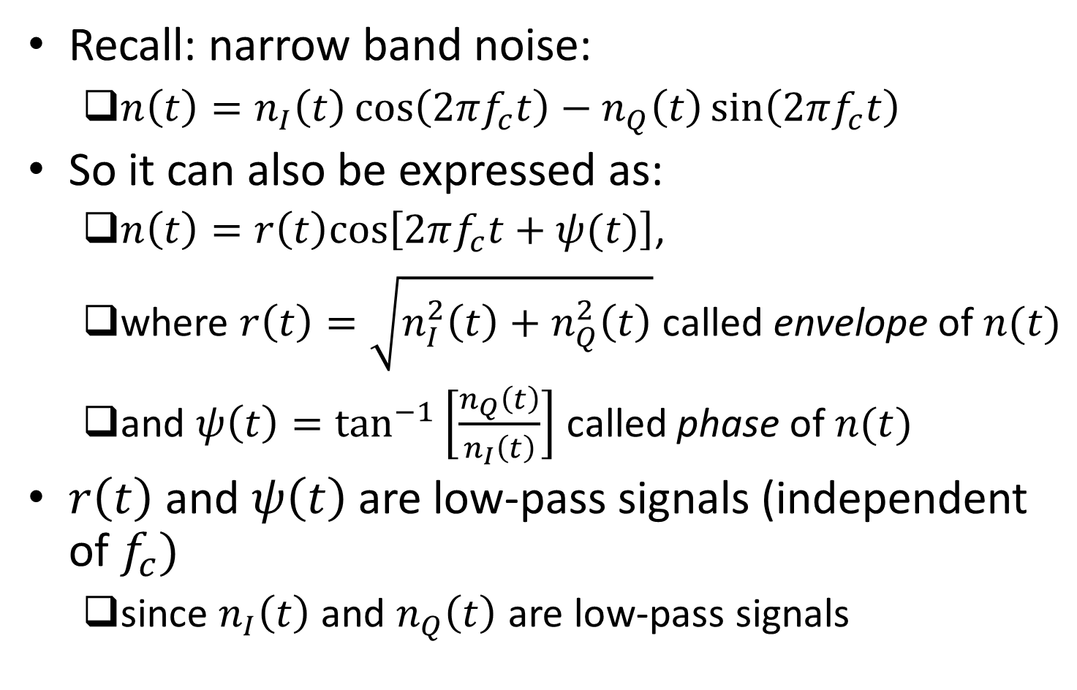
Representation of Narrowband Noise in Terms of Envelope and Phase Components
Recall: narrow band noise:
$n\left(t\right)=n_{I}\left(t\right)\cos\left(2πf_{c}t\right)−n_{Q}\left(t\right)\sin\left(2πf_{c}t\right)$
So it can also be expressed as:
$n\left(t\right)=r\left(t\right)cos\left[2πf_{c}t+ψ(t)\right]$,
where $r\left(t\right)=\sqrt{n_{I}^{2}\left(t\right)+n_{Q}^{2}\left(t\right)}$ called envelope of $n(t)$
and $ψ\left(t\right)=\tan^{−1}\left[\frac{n_{Q}\left(t\right)}{n_{I}\left(t\right)}\right]$ called phase of $n(t)$
$r\left(t\right)$ and $ψ\left(t\right)$ are low-pass signals (independent of $f_{c})$
since $n_{I}\left(t\right)$ and $n_{Q}\left(t\right)$ are low-pass signals

Slide 12
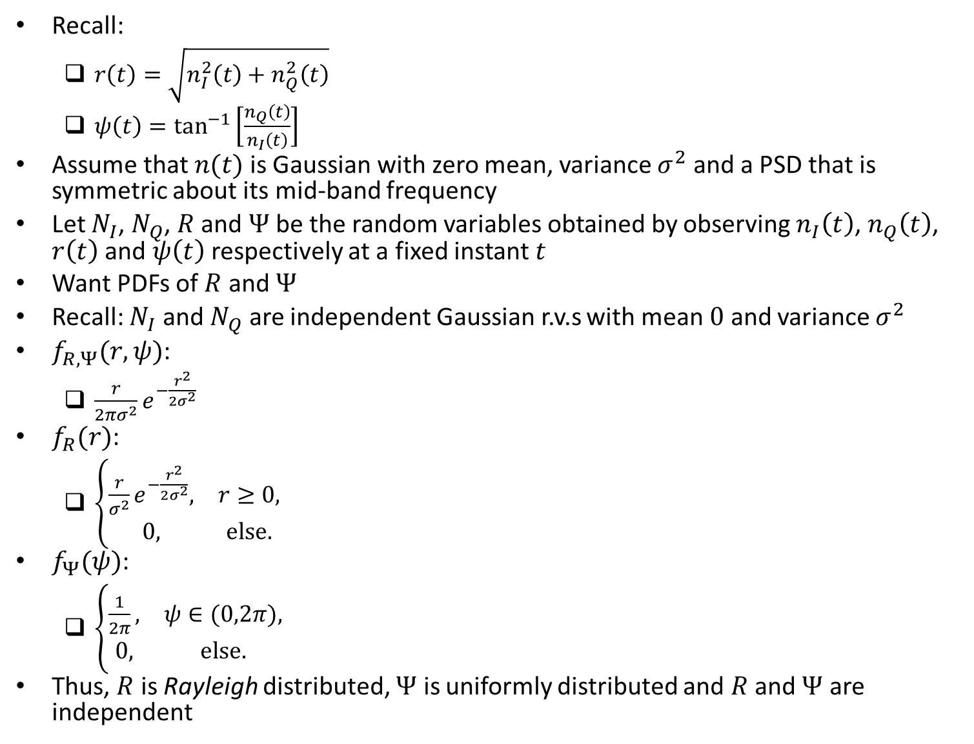
PDFs of Envelope and Phase
Recall:
$r\left(t\right)=\sqrt{n_{I}^{2}\left(t\right)+n_{Q}^{2}\left(t\right)}$
$ψ\left(t\right)=\tan^{−1}\left[\frac{n_{Q}\left(t\right)}{n_{I}\left(t\right)}\right]$
Assume that $n(t)$ is Gaussian with zero mean, variance $σ^{2}$ and a PSD that is symmetric about its mid-band frequency
Let $N_{I}$, $N_{Q}$, $R$ and $Ψ$ be the random variables obtained by observing $n_{I}\left(t\right)$, $n_{Q}\left(t\right)$, $r\left(t\right)$ and $ψ\left(t\right)$ respectively at a fixed instant $t$
Want PDFs of $R$ and $Ψ$
Recall: $N_{I}$ and $N_{Q}$ are independent Gaussian r.v.s with mean $0$ and variance $σ^{2}$
$f_{R,Ψ}(r,ψ)$:
$\frac{r}{2πσ^{2}}e^{−\frac{r^{2}}{2σ^{2}}}$
$f_{R}(r)$:
$\left\{\begin{matrix}\frac{r}{σ^{2}}e^{−\frac{r^{2}}{2σ^{2}}}, & r≥0, \\ 0, & else.\end{matrix}\right.$
$f_{Ψ}(ψ)$:
$\left\{\begin{matrix}\frac{1}{2π}, & ψ∈(0,2π), \\ 0, & else.\end{matrix}\right.$
Thus, $R$ is Rayleigh distributed, $Ψ$ is uniformly distributed and $R$ and $Ψ$ are independent

Slide 13
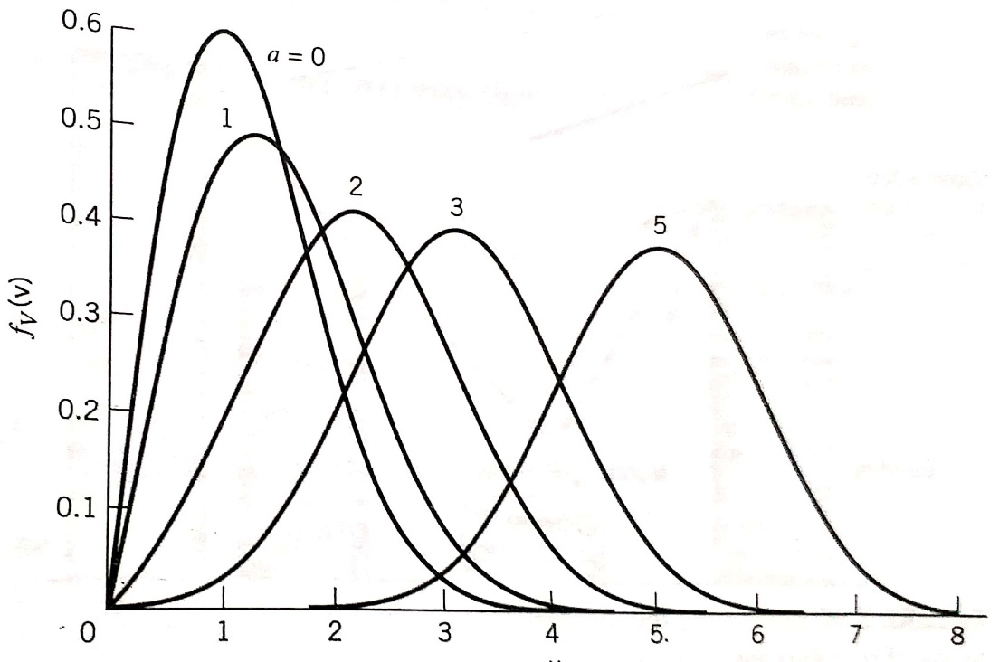
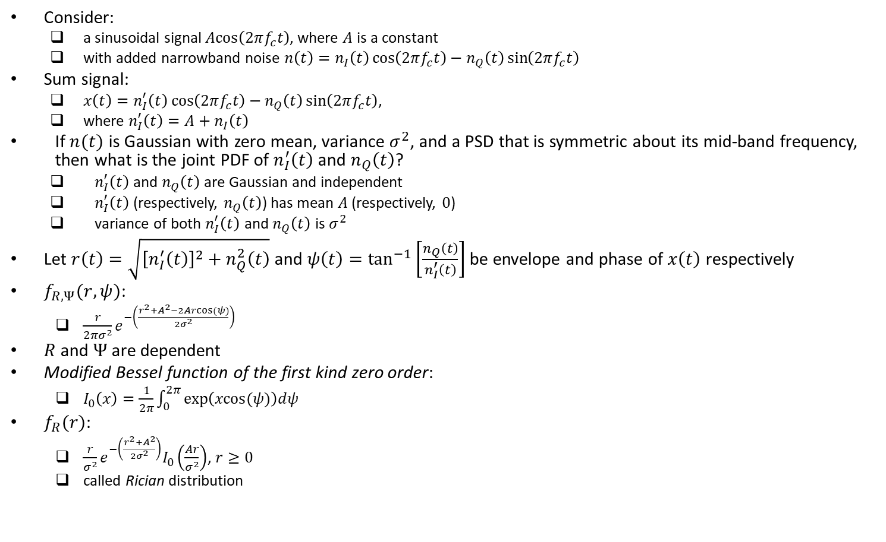
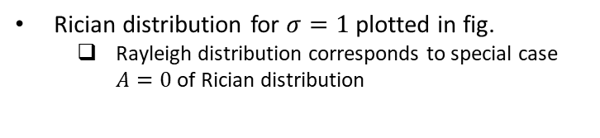
Example: Sinusoidal Signal Plus Narrowband Noise
Consider:
a sinusoidal signal $\operatorname{Acos}\left(2πf_{c}t\right)$, where $A$ is a constant
with added narrowband noise $n\left(t\right)=n_{I}\left(t\right)\cos\left(2πf_{c}t\right)−n_{Q}\left(t\right)\sin\left(2πf_{c}t\right)$
Sum signal:
$x\left(t\right)=n_{I}^{′}\left(t\right)\cos\left(2πf_{c}t\right)−n_{Q}\left(t\right)\sin\left(2πf_{c}t\right)$,
where $n_{I}^{′}\left(t\right)=A+n_{I}\left(t\right)$
If $n(t)$ is Gaussian with zero mean, variance $σ^{2}$, and a PSD that is symmetric about its mid-band frequency, then what is the joint PDF of $n_{I}^{′}\left(t\right)$ and $n_{Q}\left(t\right)$?
$n_{I}^{′}\left(t\right)$ and $n_{Q}\left(t\right)$ are Gaussian and independent
$n_{I}^{′}\left(t\right)$ (respectively, $n_{Q}\left(t\right)$) has mean $A$ (respectively, $0$)
variance of both $n_{I}^{′}\left(t\right)$ and $n_{Q}\left(t\right)$ is $σ^{2}$
Let $r\left(t\right)=\sqrt{{\left[n_{I}^{′}\left(t\right)\right]}^{2}+n_{Q}^{2}\left(t\right)}$ and $ψ\left(t\right)=\tan^{−1}\left[\frac{n_{Q}\left(t\right)}{n_{I}^{′}\left(t\right)}\right]$ be envelope and phase of $x\left(t\right)$ respectively
$f_{R,Ψ}(r,ψ)$:
$\frac{r}{2πσ^{2}}e^{−\left(\frac{r^{2}+A^{2}−2Arcos(ψ)}{2σ^{2}}\right)}$
$R$ and $Ψ$ are dependent
Modified Bessel function of the first kind zero order:
$I_{0}\left(x\right)=\frac{1}{2π}\int_{0}^{2π}{exp\left(xcos(ψ)\right)dψ}$
$f_{R}(r)$:
$\frac{r}{σ^{2}}e^{−\left(\frac{r^{2}+A^{2}}{2σ^{2}}\right)}I_{0}\left(\frac{Ar}{σ^{2}}\right)$, $r≥0$
called Rician distribution
Rician distribution for $σ=1$ plotted in fig.
Rayleigh distribution corresponds to special case $A=0$ of Rician distribution
Ref: “Communication Systems” by Haykin and Moher, 5th ed

Slide 14
Physical Relevance of Rayleigh and Rician Distributions
If a transmitter sends a signal to a receiver through an environment that consists of a large number of scatterers, and no direct path exists from transmitter to receiver, then:
envelope of received signal approximately has Rayleigh distribution
If a transmitter sends a signal to a receiver through an environment that consists of a large number of scatterers, and a direct path exists from transmitter to receiver then:
envelope of received signal approximately has Rician distribution

